Slide 1

BRIGHTTV
Growing the
Subscription
Base
A data-driven roadmap for the financial year
CEO Presentation · Q1 2016 · 10k sessions · 4.4k subs

Slide 2
SLIDE 01 · Global View
Global Snapshot
5,375
10 000
21
TOTAL SUSCRIBERS
Viewing Sessions
Active Channels
Q1 2016
Logged in quarter
Available
BrightTV • CEO Presentation • Growing Subscription Base
07 / 09

Slide 3
SLIDE 02 · OVERVIEW
Executive Summary
KEY FINDINGS
RECOMMENDATIONS
Live sports & music drive peaks Supersport Live, ICC Cricket and Channel O lead consumption. Geographic concentration Gauteng & Western Cape dominate; other provinces underserved. Low engagement per session ~38% of sessions <1 min; median 1m 48s — heavy surfing. Unknown profiles ~2.6% of records lack demographics — minor but addressable.
Target underserved provinces Localised content & promotions in Limpopo, Mpumalanga, NC, FS. Grow female viewership Add lifestyle & drama; partner with female influencers. Bundle live sports events Use marquee events as the primary acquisition driver. Capture the overnight window 00:00–05:00 is <10% of peak — late-night sports & catch-up.
BrightTV • CEO Presentation • Growing Subscription Base
02 / 09

Slide 4

SLIDE 03 · AUDIENCE
User Profile Overview
TOP PROVINCES
GENDER SPLIT
Share of viewers
90%
male
Male 90%
Female 10%
26–35
Most active age group
Followed by 18–25
WHO IS WATCHING
Today: 26–35, urban, heavily male.
Untapped: women (90% gap), rural provinces, seniors.
2.6%
Unknown profiles
Missing age / gender
BrightTV • CEO Presentation • Growing Subscription Base
03 / 09

Slide 5
SLIDE 04 · BEHAVIOUR
Usage Trends — When & What They Watch
VIEWERSHIP BY HOUR
TOP CHANNELS BY SESSIONS
Indexed sessions, SA local time
1
Supersport Live Events
Sports
2
ICC Cricket World Cup
Live sports
3
Channel O
Music
4
Trace TV
Music · Urban
5
SuperSport Blitz
Sports highlights
PEAK HOURS
BEST DAYS
SESSION LENGTH
12:00 – 20:00
Sat & Sun
Median 2 min
Daytime sustained 10:00–20:00; peak 15:00–17:00.
+30% vs weekdays. Wednesday is the lowest weekday.
38% of sessions <1 min. Live sports drives multi-hour outliers.
BrightTV • CEO Presentation • Growing Subscription Base
04 / 09

Slide 6
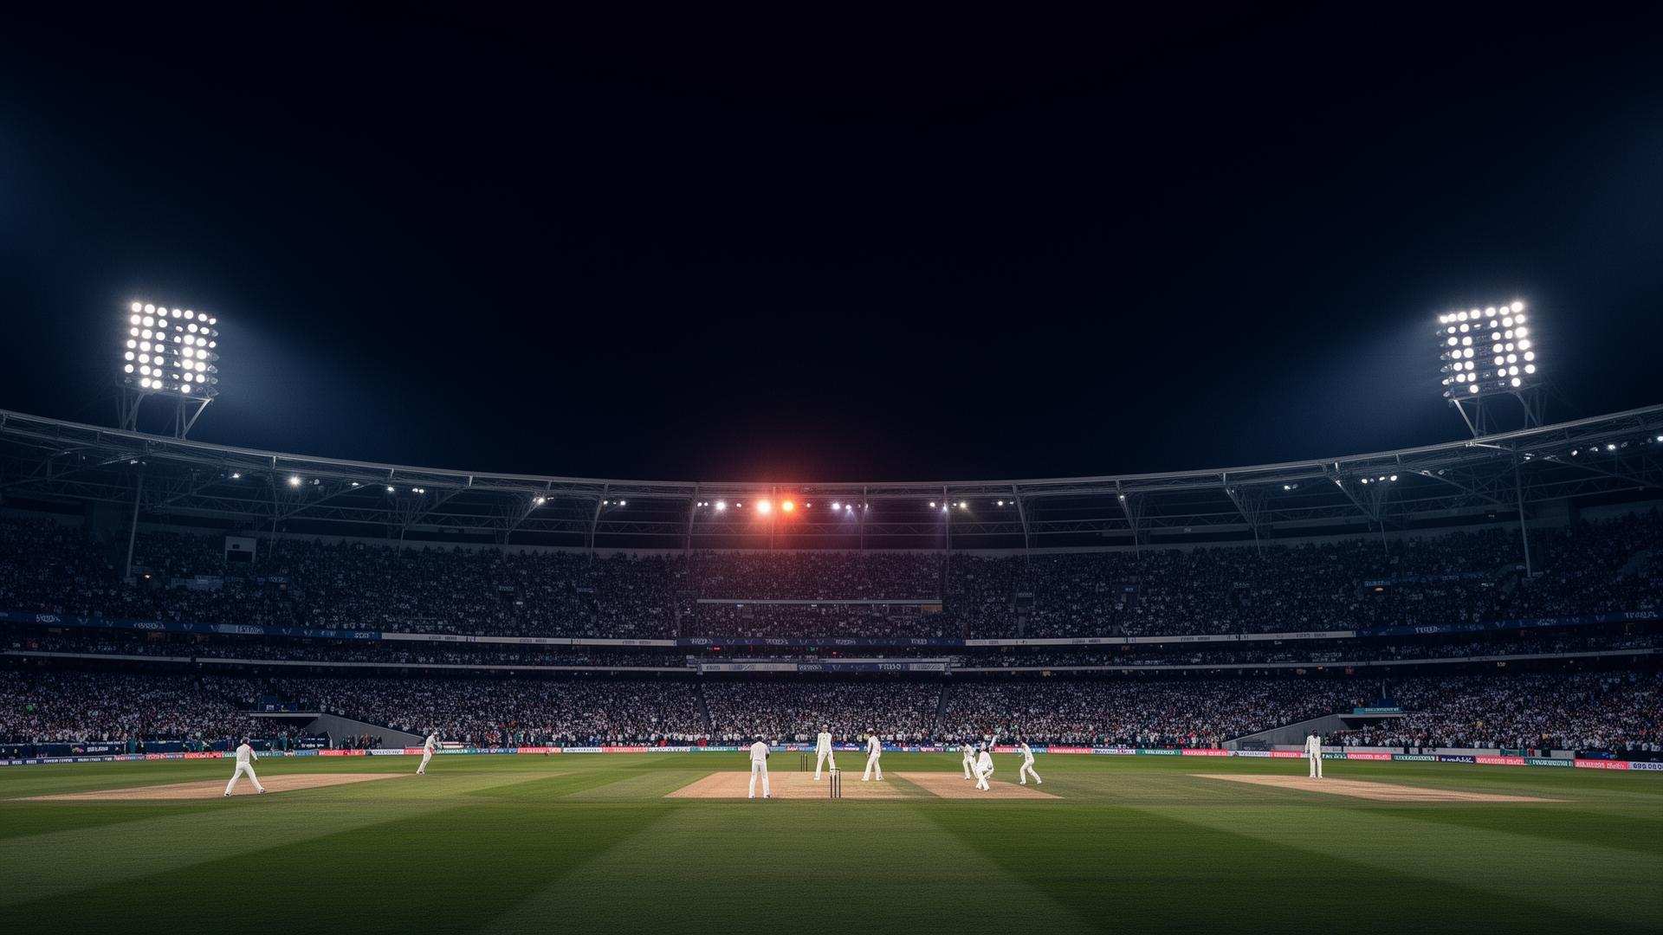
SLIDE 05 · DRIVERS
Factors Influencing Consumption
Factor
Impact
Example
Live Events
Very High
Cricket World Cup sessions exceed 2 hours.
Time of Day
High
Sustained 12:00–20:00; peak 15:00–17:00.
Day of Week
Medium
Weekend consumption ~30% higher than weekdays.
KEY INSIGHT
Event-driven consumption is the strongest lever.
Age Group
Medium
Kids drive cartoons; adults drive sports & news.
Subscribers tune in for live, exclusive content. Acquire rights, package premium, and market each event as a moment.
Province
Medium
Gauteng skews sports; rural skews entertainment.
Session Duration
Low
Most sessions short — content discovery is weak.
BrightTV • CEO Presentation • Growing Subscription Base
05 / 09

Slide 7
SLIDE 06 · 00:00 – 05:00
Capturing the Overnight Window
Target Audience
Recommended Content
Expected Lift
ALSO PLANNED
Shift workers & insomniacs
Late-night news & talk loops (CNN, kykNET)
Auto-loop premium sports highlights from earlier in the day. “After Hours” zone — curated late-night programming for shift workers, students and night owls.
+25%
Sports fans (global events)
Live overseas fixtures: EPL, NBA, MLB (Supersport)
+40%
Young adults (18–25)
Late-night music video blocks (Channel O, Trace TV)
+30%
Movie buffs
Cult classics & marathons (M-Net, Africa Magic)
MEASURABLE GOAL
+20%
+30%
overnight (00–05) consumption within 3 months.
BrightTV • CEO Presentation • Growing Subscription Base
06 / 09

Slide 8
SLIDE 07 · FIVE BETS
Strategic Initiatives to Grow the User Base
01
02
03
Geographic Expansion
Grow Female Subscribers
Reduce Unknown Profiles
Localised marketing in Limpopo, Mpumalanga, NC, FS. Free weekend trials. Shift 15% of marketing spend.
Add lifestyle, drama and reality lineups. Partner with local female influencers. Target +40% female sign-ups in Q2.
Incentivise profile completion (e.g., one-month free premium sports). Better personalisation → higher retention.
04
05
Sports as Acquisition Engine
Overnight Activation
Secure rights for soccer & rugby. Sports-only entry packs. Target +50% new subs during major events.
“After Hours” block 00:00–05:00. Late-night sports, music & movies. Push notifications to night-active users.
BrightTV • CEO Presentation • Growing Subscription Base
07 / 09

Slide 9
SLIDE 08 · NEXT 3 MONTHS
Implementation Roadmap
MONTH 1
MONTH 2
MONTH 3
“After Hours” overnight pilot
Regional marketing — LP & MP
Sports-only pack pilot
Owner CVM Team
Owner Sales
Owner Product
KPI +25% 00–05 consumption
KPI +5k new subs each
KPI 10k pilot subscribers
Profile completion campaign
Female-targeted content launch
Performance review & scale
Owner Marketing
Owner Content Team
Owner Exec Office
KPI Unknown 2.6% → 1%
KPI Female sign-ups +20%
KPI Approve full rollout
TOTAL IMPACT 25,000 – 35,000 new subscribers within 3 months
BrightTV • CEO Presentation • Growing Subscription Base
08 / 09

Slide 10

SLIDE 09 · WRAP-UP
Q&A and Next Steps
DATA LIMITATIONS NOTED
IMMEDIATE ACTIONS
Honest caveats for the board
What we need from you today
Coverage
Dataset only covers Jan–Mar 2016 — seasonal effects may exist.
1
Approve the “After Hours” overnight pilot (00:00–05:00).
Bias
Unknown users may bias age and gender insights.
2
Allocate budget for regional marketing in LP & MP.
Retention
No churn or cancellation data — partner with CVM for analysis.
3
Task content team to acquire two female-focused shows.
A detailed dashboard with daily consumption heatmaps and demographic segmentation will be delivered within one week.
Thank you · Questions?
BrightTV • CEO Presentation • Growing Subscription Base
09 / 09

